Slide 1
W-9 Form
Request for Taxpayer Identification Number and Certification

Slide 2
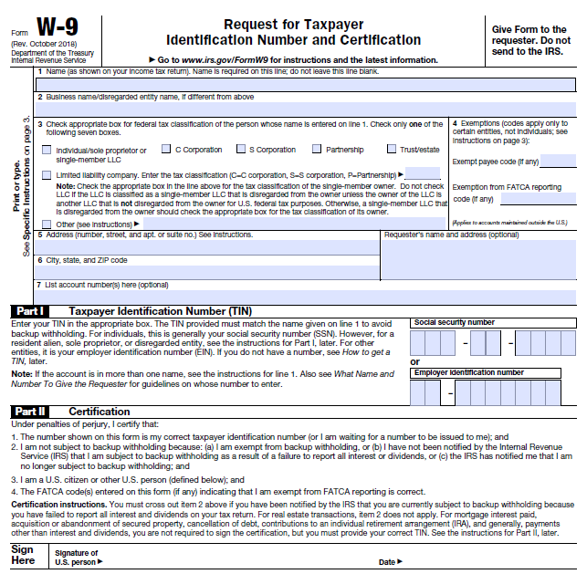
Line 1 Full Name (as shown on your income tax return).
Line 2 If different from line 1 enter Business Name, Trade Name, DBA Name or disregarded Entity Name.
Line 3 Federal Tax Classification for the person/entity whose name is entered on line 1 (check only one of the boxes).
Line 4 Exemption: Only enter in the appropriate space, if you are exempt from backup withholding and/or FATCA reporting.
Line 5 Enter your full address.
Line 6 Enter your City, State and ZIP Code.
Part I - Taxpayer Identification Number (TIN)
Enter your TIN in the appropriate box.
Note: Entering “Applied For” means that you have already applied for a TIN or that you intend to apply for one soon.
Part II - Certification
To establish to the withholding agent that you are a U.S. person (it also refers to a U.S. entity), or resident alien, sign Form W-9 and place the date.
Please see page 3, 4 & 5 under Specific Instructions for further detailed clarification.

